Slide 1
Partitioning and Consistent Hashing
Reference: https://www.youtube.com/watch?v=UF9Iqmg94tk

Slide 2
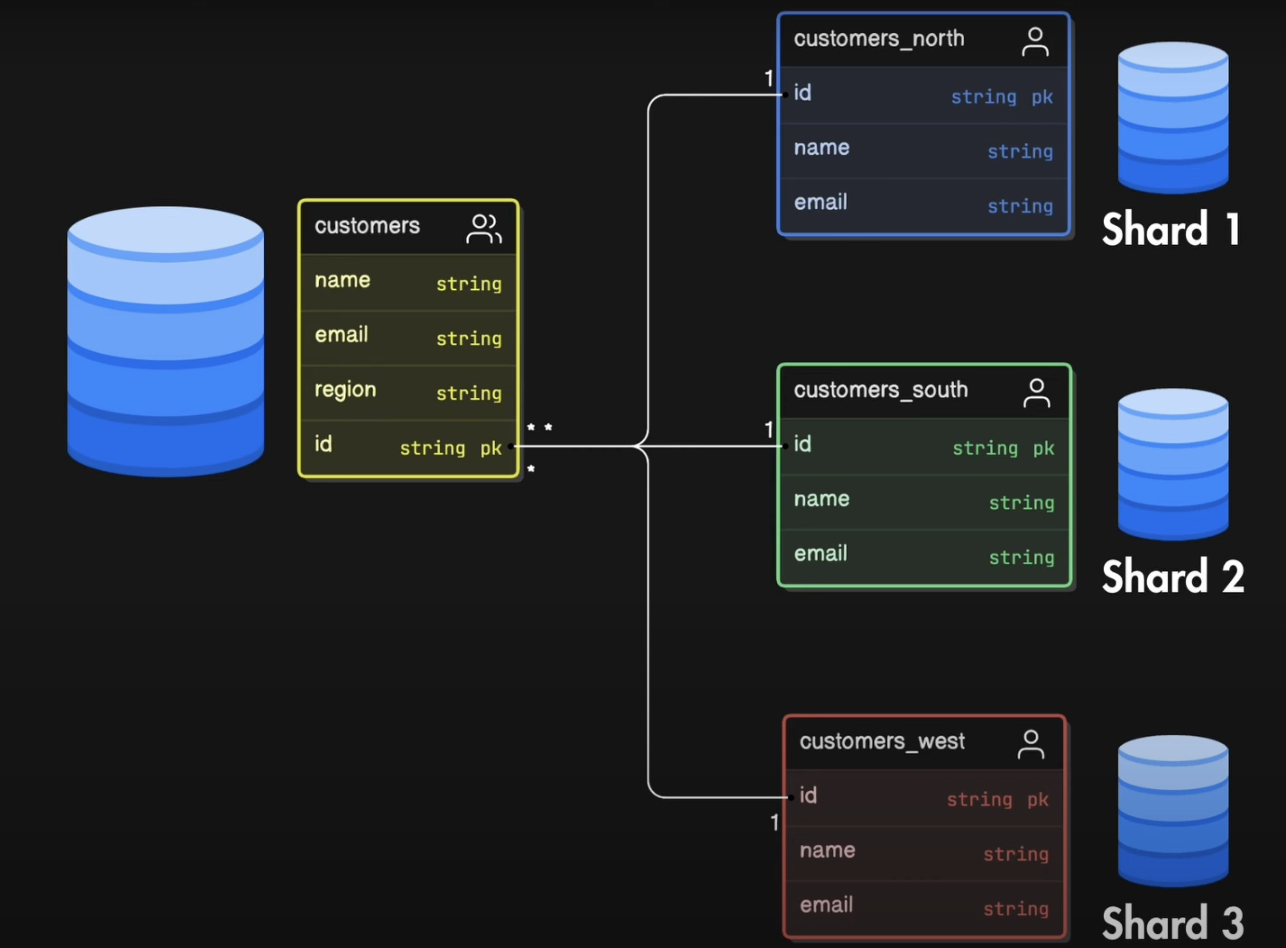
Partitioning is a generic word that refers to Horizontal Scaling => Sharding is one partitioning approach.
Sharding consists into store data into different servers => to decide where the data will be stored, we need to choose a key.
Keys are usually:
Or and ID (for example a userID)
Or the geographical location
Shard Keys determine how the data are
assigned to shards.

Slide 3
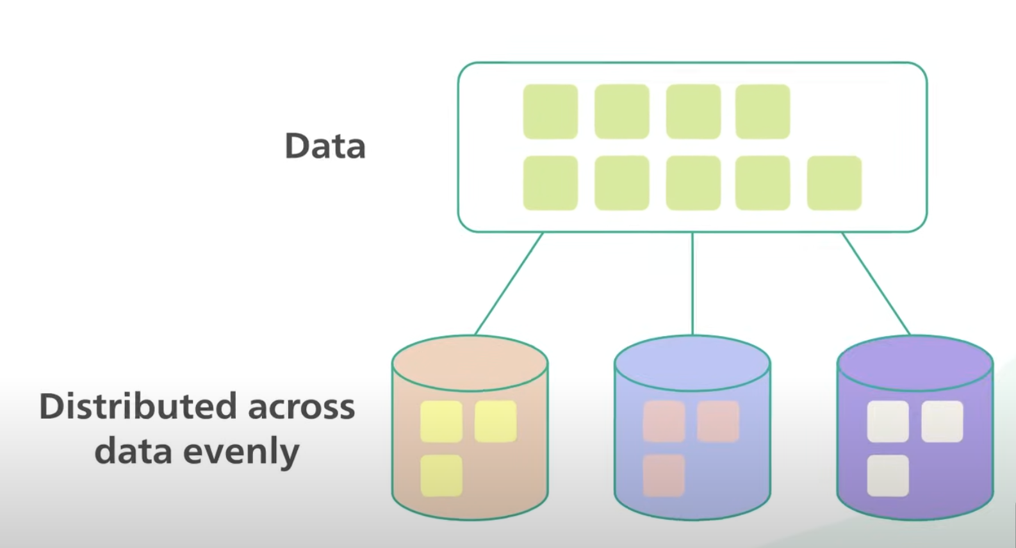
Problem to solve:
In data partitioning we store the data in several servers.
But the problem is that we want to distribute the data evenly across the servers => we do NOT want a server to store the majority of the data

Slide 4
Simple Hashing

Slide 5

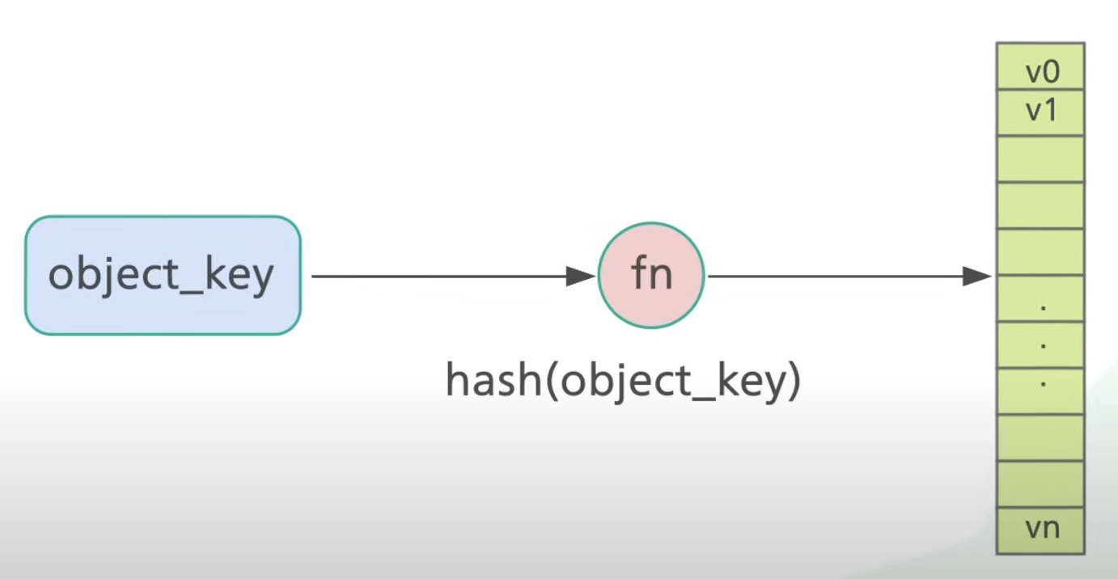
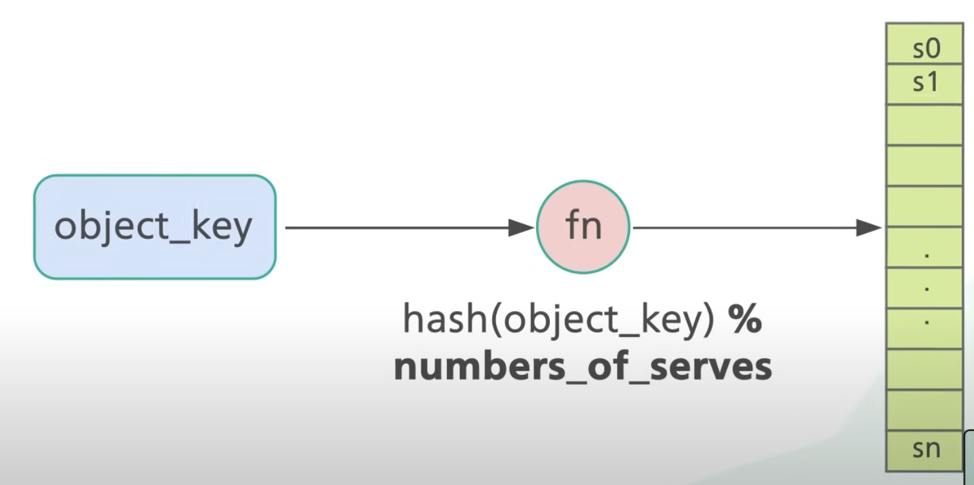
A common method to distribute data is to use a hash function.
Step 1: take the key of the data object you want to store and apply the hash function => this returns an ID that identify the “key” of your hash-map
Step 2: We apply the “module” of the result given by the hash function is then with the number of servers we have => this is done do decide in which server the data will be stored.

Slide 6
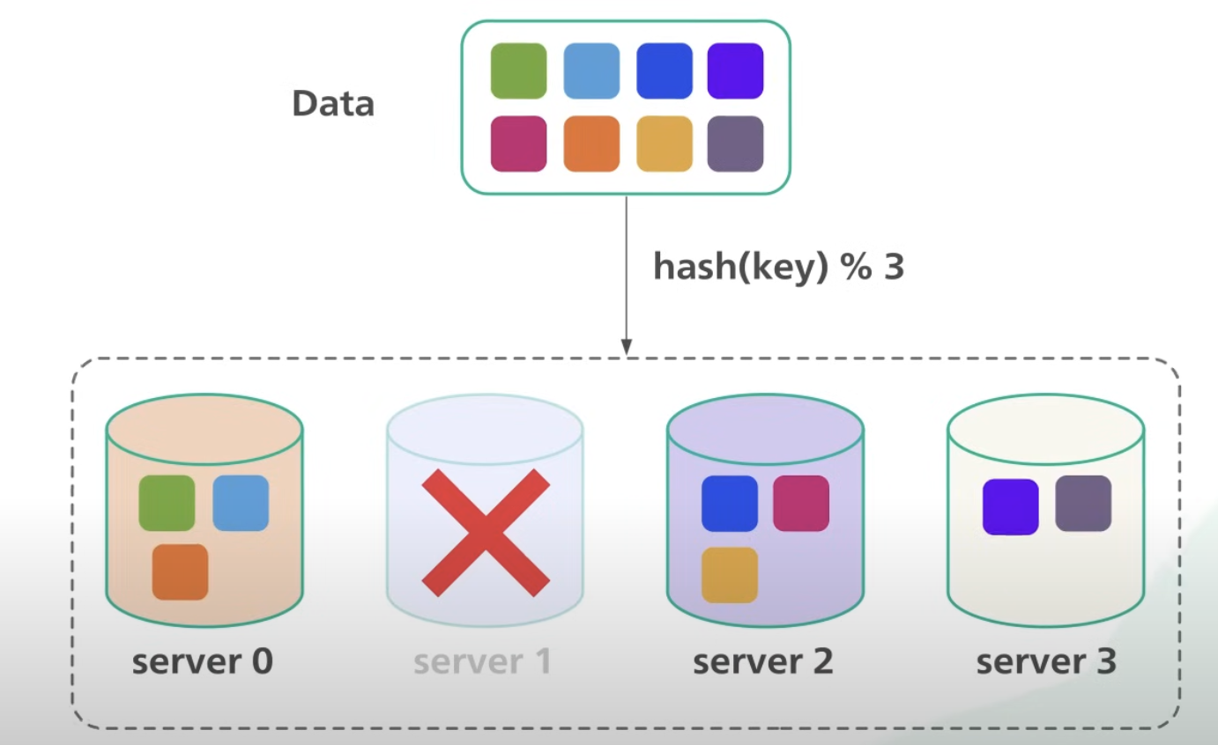
This Approach works well when:
the size of the cluster is fixed
In reality new servers are added on-demand (to meet the demand) or removed from the pool of servers.
=> The impact is DRASTIC => You would need to re-distribute MOST of the keys (we do not re-distribute only the keys of the DB that is now offline, but even the keys which were already places in the servers that are still active).
Consistent Hashing is an effective technique to MITIGATE this issue

Slide 7
Consistent Hashing

Slide 8
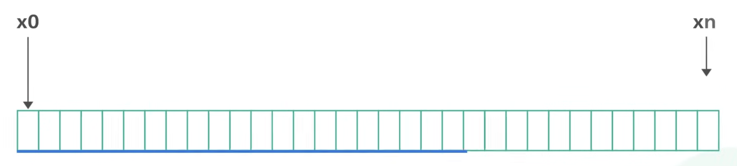
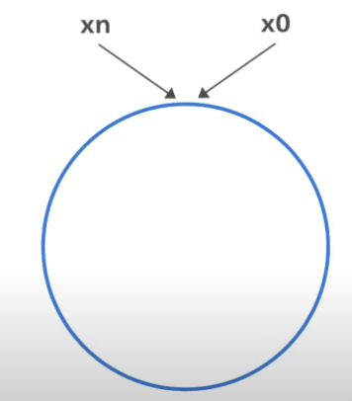
The foal of Consistent Hashing is that we want almost ALL the objects to stay assigned to the same server. When we add or remove servers, the impact should be minimal and involving only a small sets of data/keys.
The range of value from x₀ to x_{n} is called the “hash space”
The two sides of the “Hash Space” are connected to form a ring

Slide 9
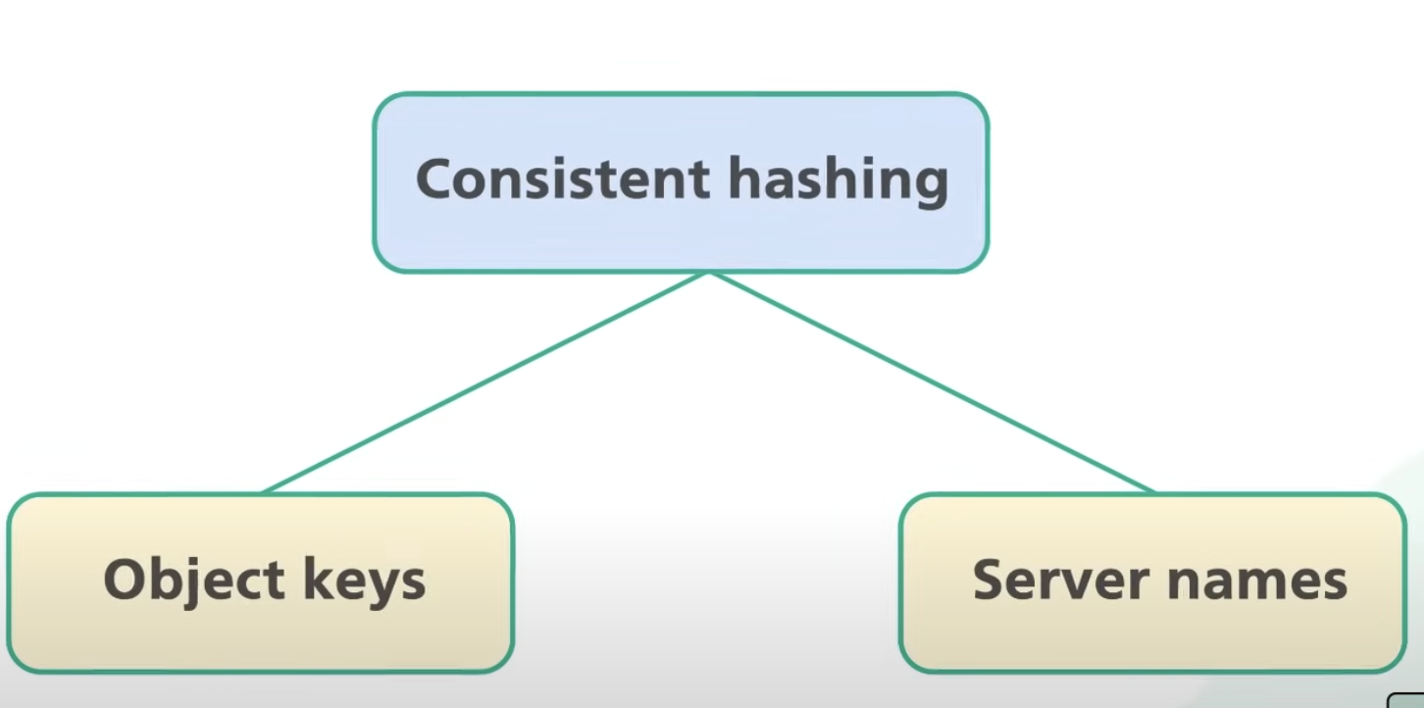
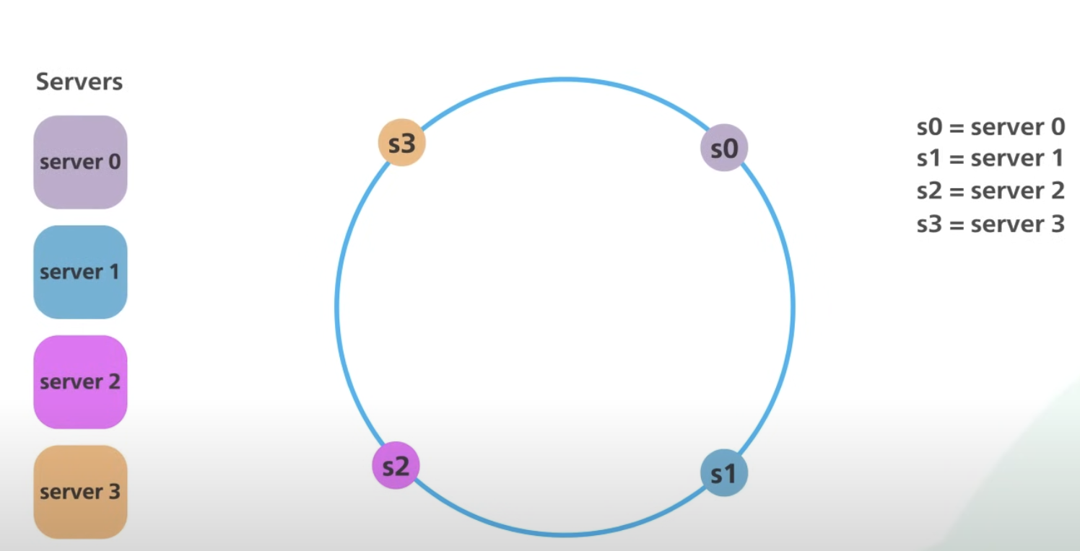
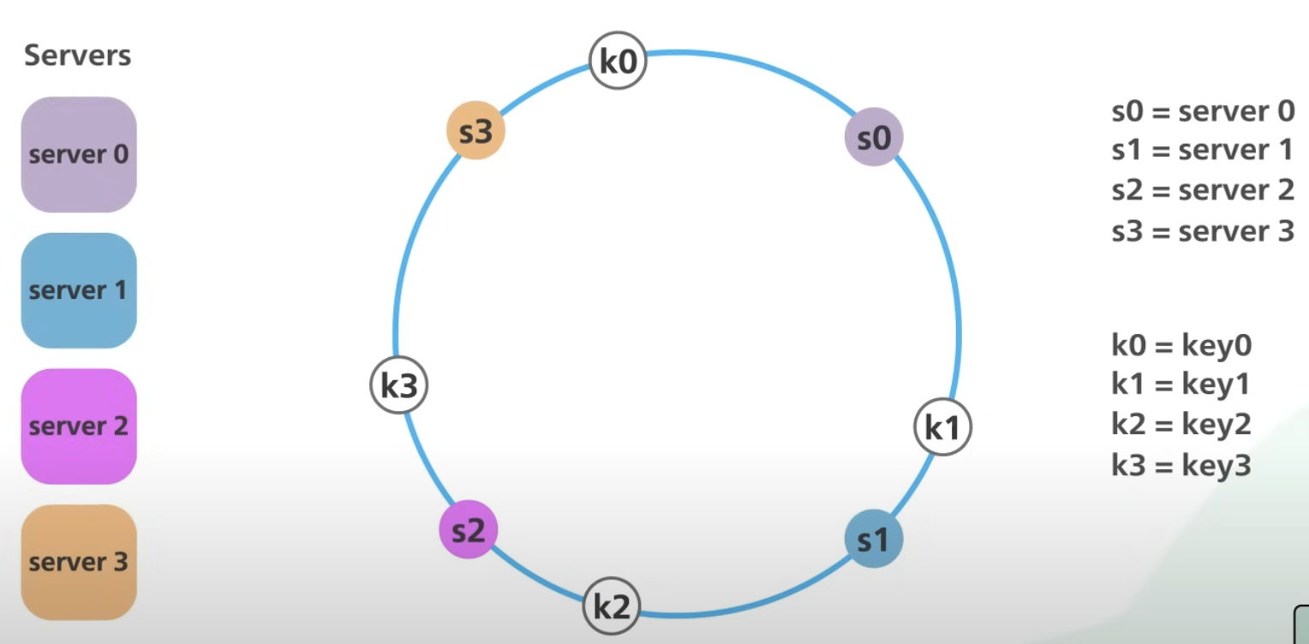
In Consistent Hashing instead of hashing only the object key, we hash also the servers name or IP.
In this way we can placed not only the object keys (data) in the ring, but also the server itself are placed into the ring.
Then we use the same hashing function to the object keys (the data) and place the keys into the ring (where there are also the servers as well)

Slide 10
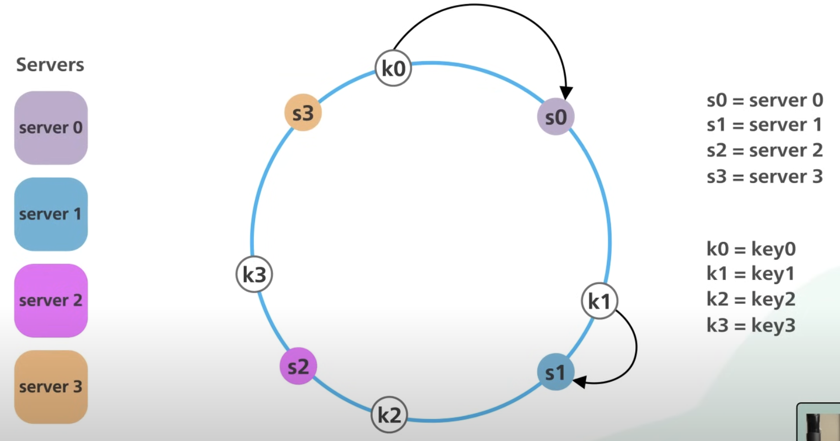
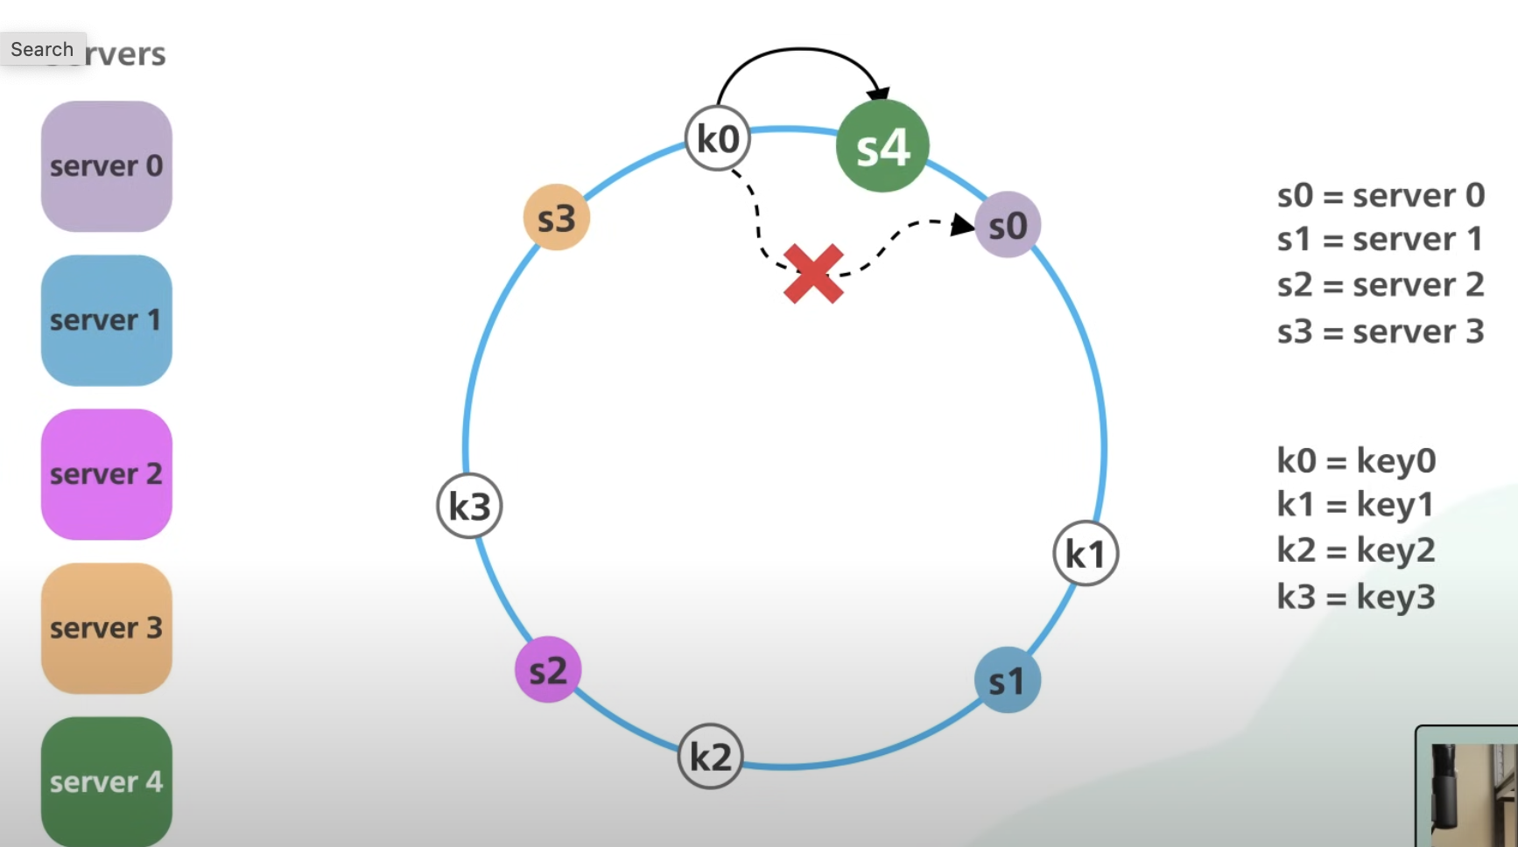
To decide what server should store the data => we go clockwise searching for a server, until a server is found.
When a new server is added (or removed), for example S4 is added, only a small part of keys/data has to be updated and located in the new server.
Only k0 in the example =>

Slide 11
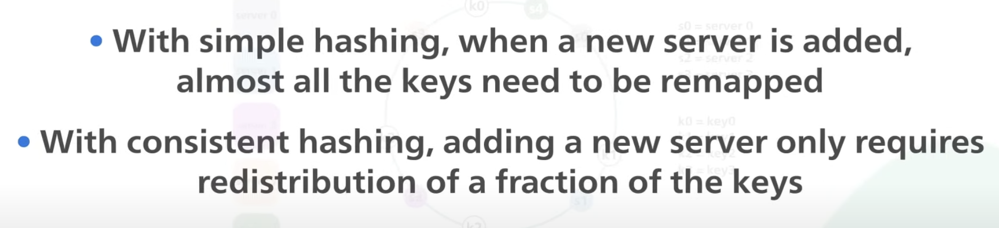
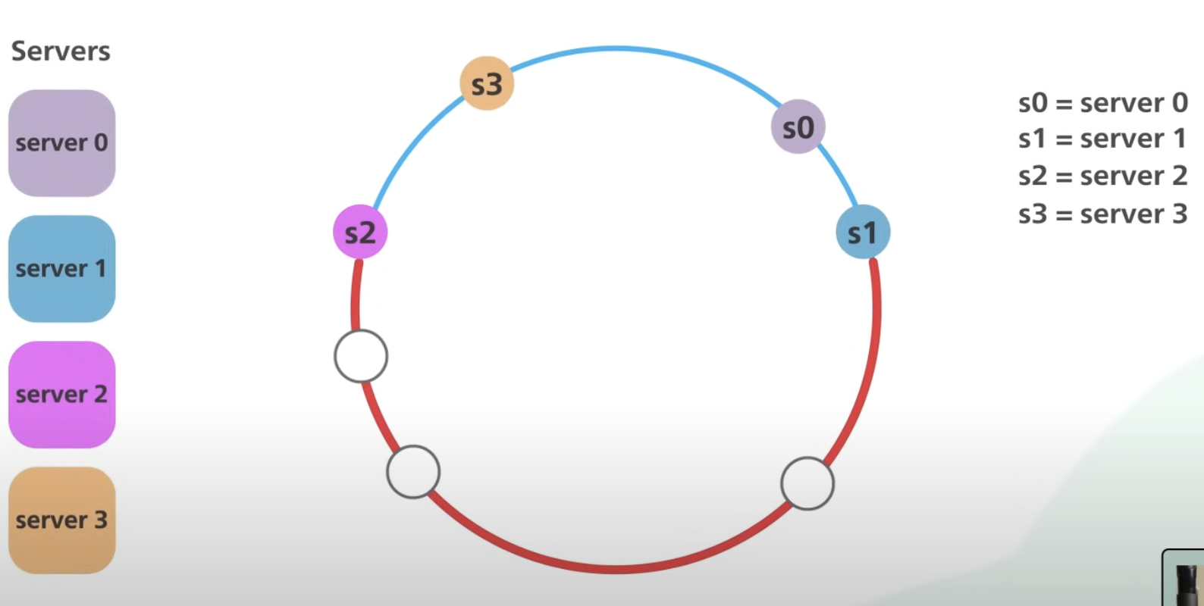
Advantage of Consistent Hashing over Simple Hashing:
However, there are still some issue with Consistent Hashing! The problem is that the distribution of the servers in the ring is unlucky going to be UNEVEN => no equal segments!
In this example: most of the objects are store in S2.

Slide 12
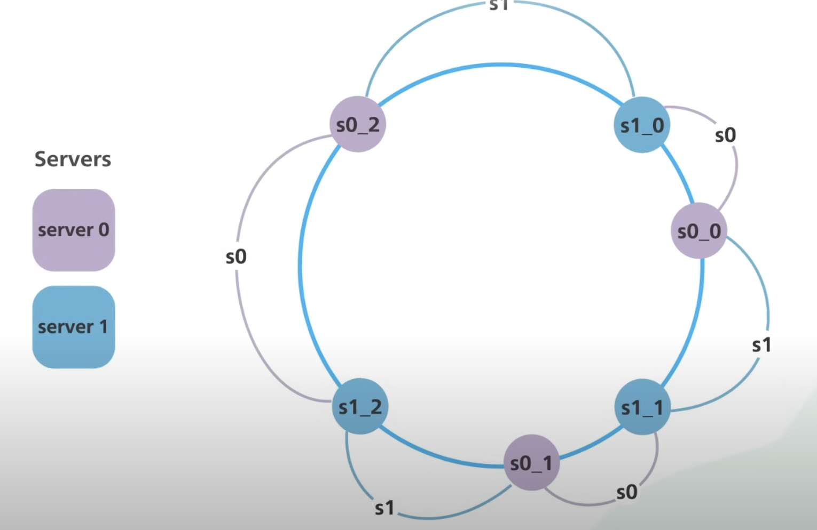
How to Fix this problem?
The solution is to use “virtual” nodes in the Hash Space.
A physical node will appear in different locations on the circular array.
Each server handle multiple segments on the circular array.
S0 managed 3 segments.
S1 managed the other 3 segments.

